Slide 1
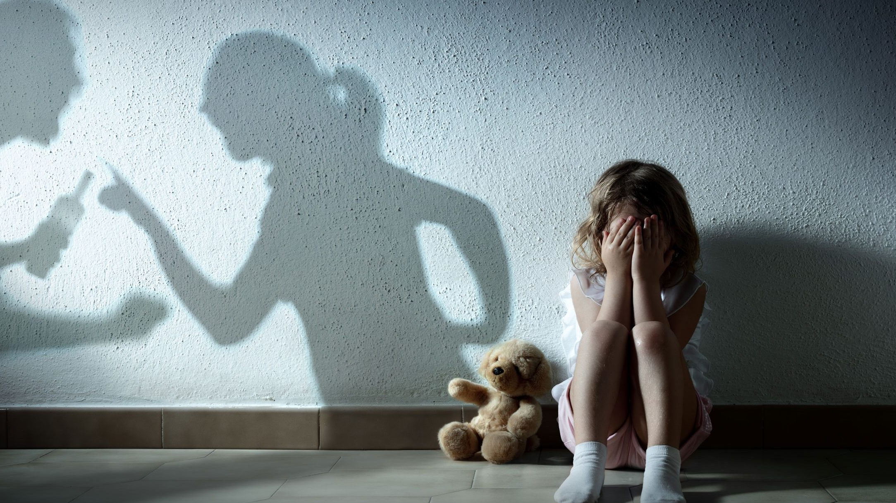
Family, children, domestic violence, abuse
Week 4

Slide 2
Explain what is meant by the following term:
IPV

Slide 3
Explain what is meant by the following term:
IPV = Intimate partner violence.
A form of domestic violence between partners in an intimate relationship.

Slide 4
Explain what is meant by the following term:
stalking

Slide 5
Explain what is meant by the following term:
stalking – to repeatedly follow or make contact with someone, either in person or by phone calls, social media etc.

Slide 6
Explain what is meant by the following term:
gaslighting

Slide 7
Explain what is meant by the following term:
gaslighting – manipulating someone such that they begin to question their own perception of reality.

Slide 8
Explain what is meant by the following term:
coercive control

Slide 9
coercive control
A form of psychological abuse designed to manipulate and control the victim. Can include:
Isolating the victim (stopping them seeing family/friends)
Intimidating the victim
Degrading (belittling, humiliating) the victim
Controlling their finances, what clothes they can wear etc.

Slide 10
Explain what is meant by the following term:
bride kidnapping / ala kachuu

Slide 11
bride kidnapping / ala kachuu
A man taking away (by force) a woman he wants to marry. He keeps her at a secret place until she agrees to marry him.
Ala kachuu is the name for bride kidnapping in Kyrgyzstan

Slide 12
consensual / non-consensual

Slide 13
consensual / non-consensual
consensual = the person agrees to it
non-consensual = the person hasn’t agreed to it

Slide 14
Explain what is meant by the following term:
to elope

Slide 15
to elope – to run away to get married secretly

Slide 16
Explain what is meant by the following term:
patriarchal norms

Slide 17
patriarchal norms
– dominance and control over women by men is considered socially acceptable

Slide 18
misogyny

Slide 19
misogyny
a dislike for, or deep prejudice against women.

Slide 20
victim-blaming

Slide 21
victim-blaming
the victim of a crime, accident etc. is held partially or entirely responsible for what happened to them

Slide 22
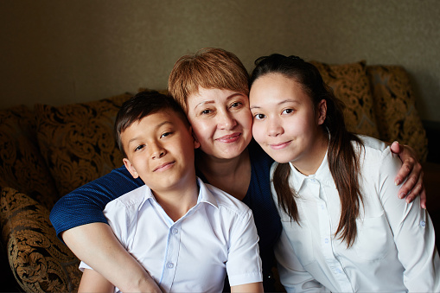
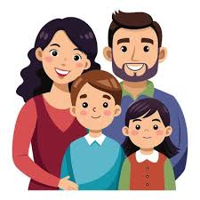
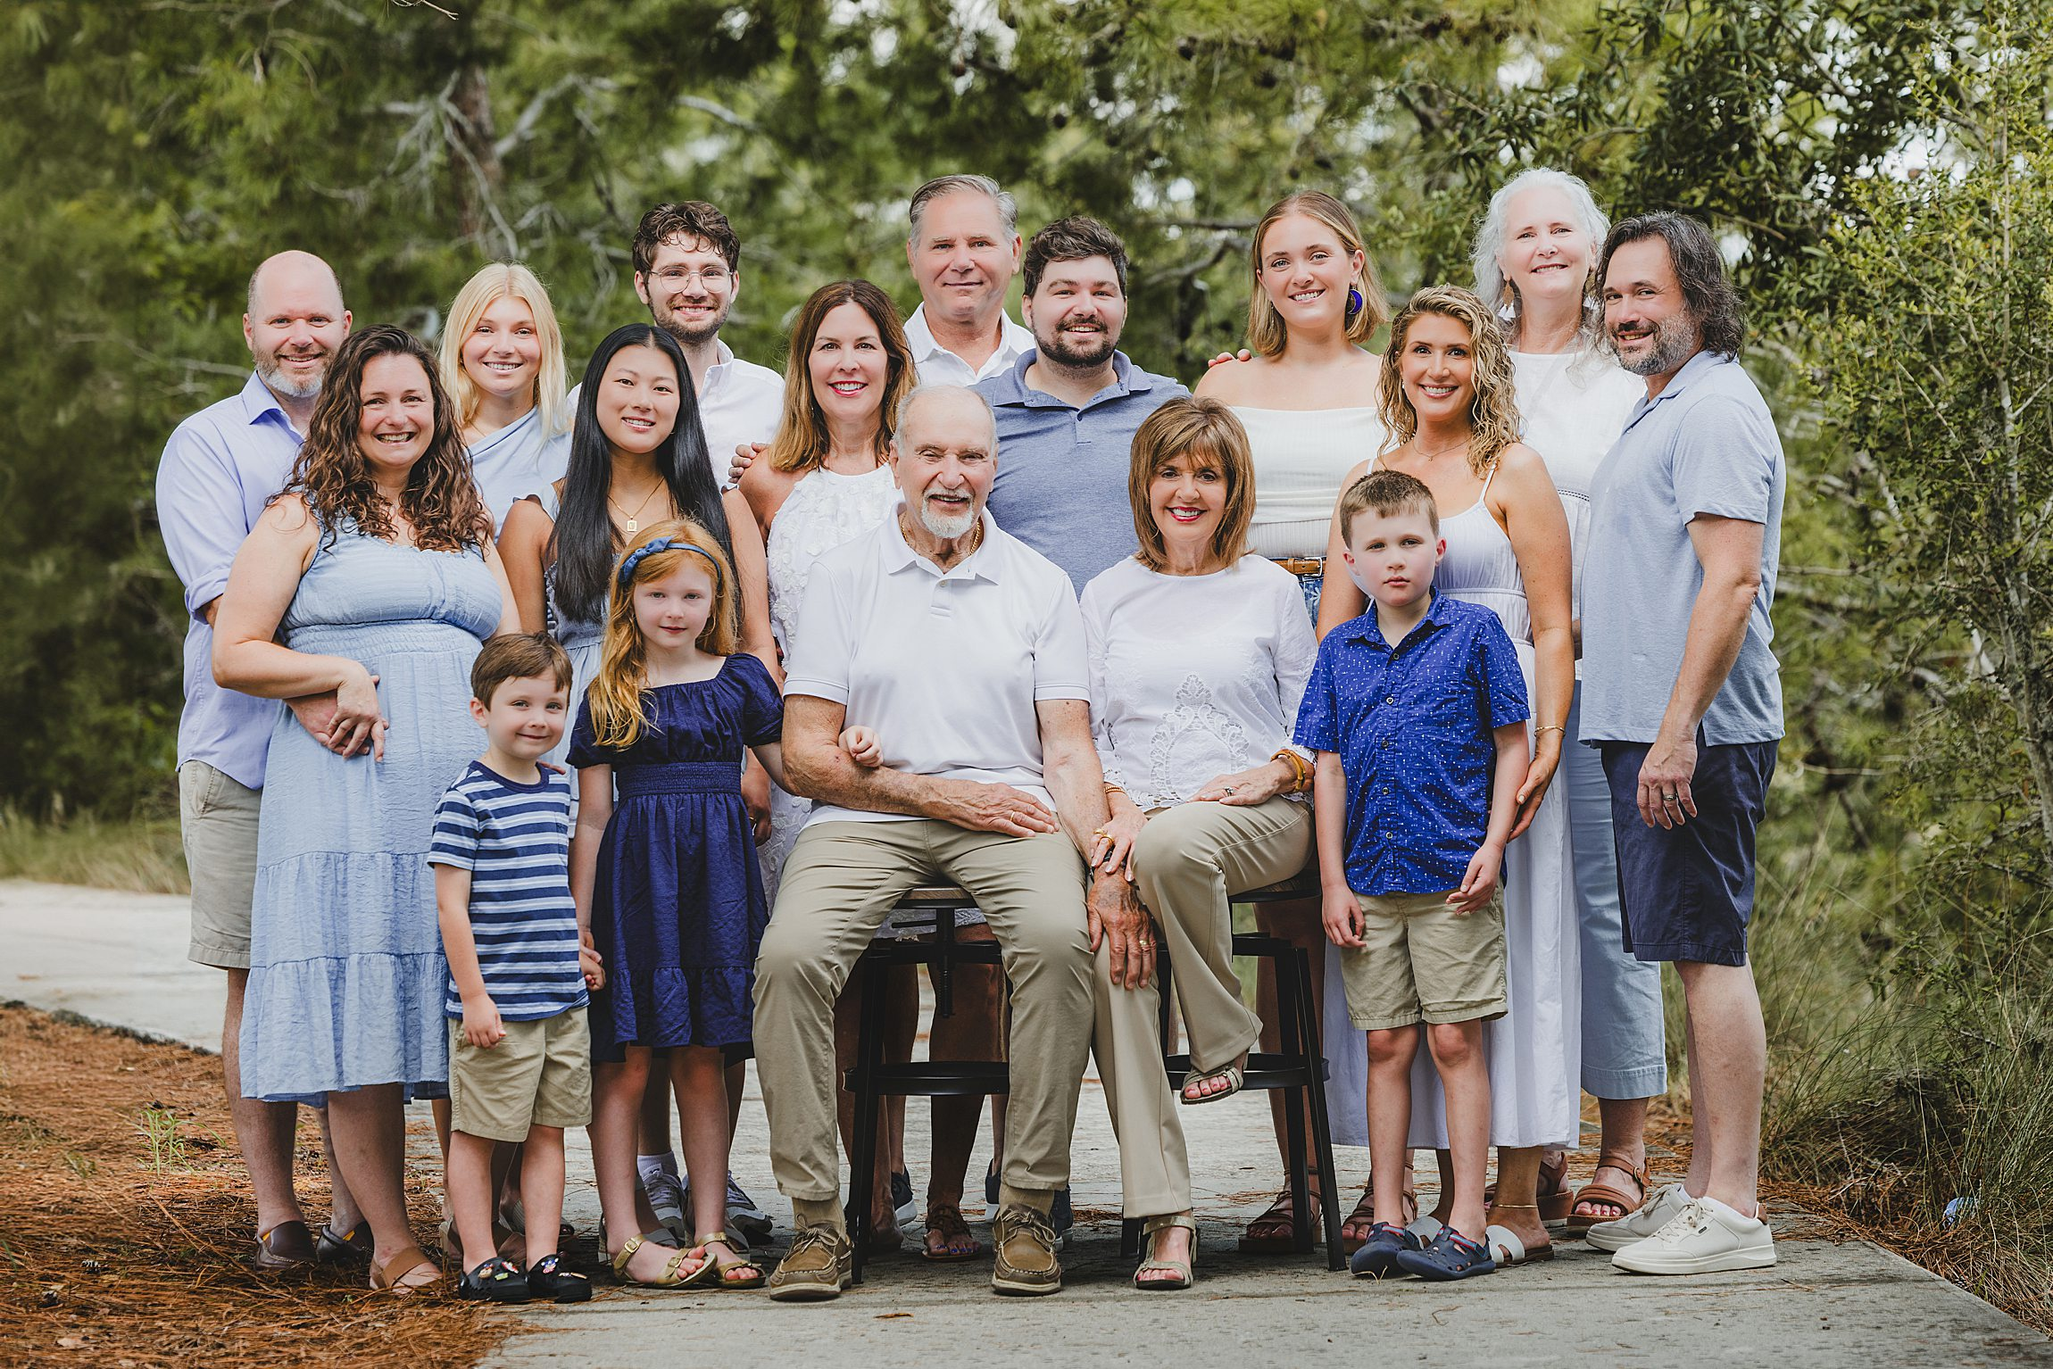
What different types of family are there?
nuclear:
two parents and their dependent children
extended:
several generations, such as grandparents, aunts, uncles, and cousins, who live together or maintain strong daily connections
single-parent:
one parent raising children alone
can be due to divorce/separation
or an unmarried woman giving birth.
cohabiting:
a couple lives together without marriage

Slide 23
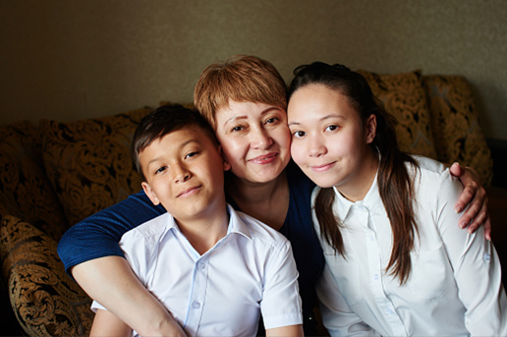
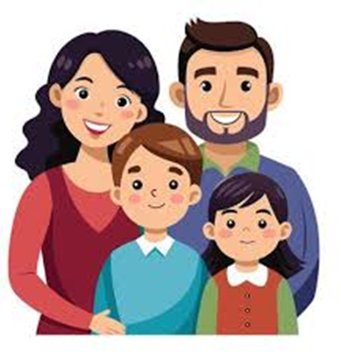
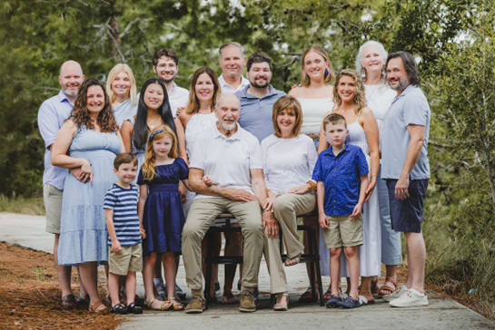
Are any of these family types considered deviant or stigmatised in Kazakhstan? [your opinion]

Slide 24
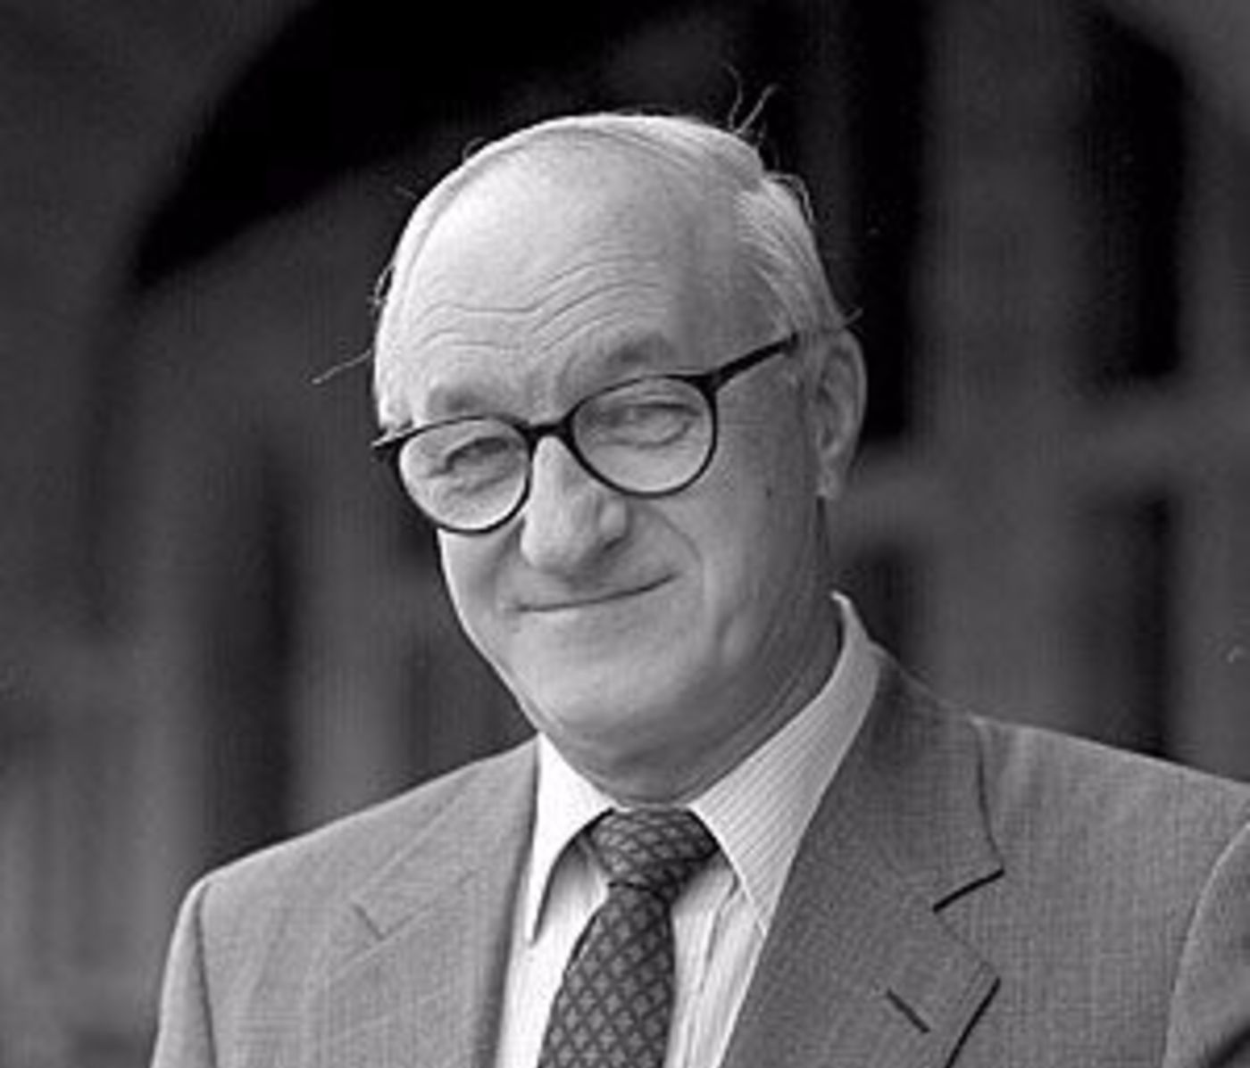
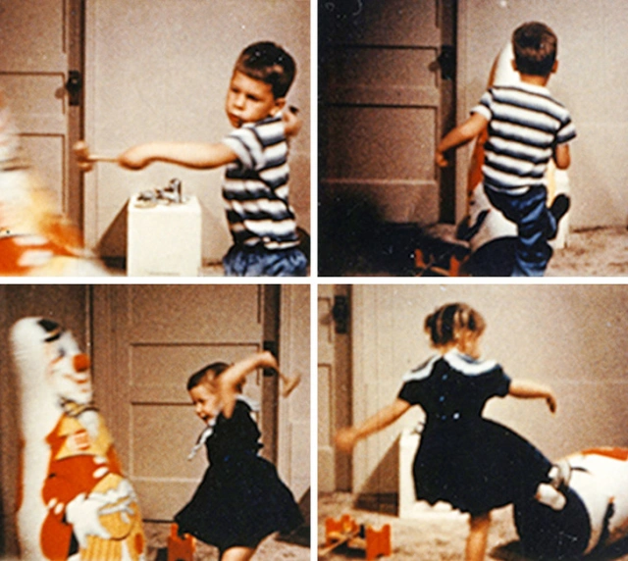
What is Social Learning Theory?
Albert Bandura
Bobo doll experiment
Main finding: children copy the violence of adult models
They are even more likely to copy if the adult model is of the same gender
Video here [to 3:10]

Slide 25
What insights does the psychological theory Social Learning Theory give us into forms of abuse such as domestic violence and child abuse?
They are learned behaviours
People who witnessed or experienced domestic violence/abuse as a child are more likely to repeat those behaviours as adults
Leads to cycles of abuse

Slide 26
According to Social Learning Theory, what interventions are needed to help prevent abuse?
Need to break the cycle of learned behaviours
Individual level interventions:
counselling
teaching alternative behaviours (e.g. non-violent ways of resolving conflicts)
Societal level interventions:
educational programmes

Slide 27
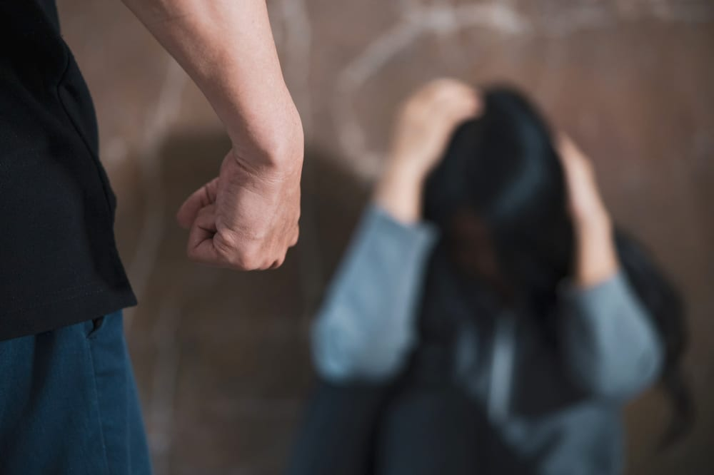
What types of abuse can domestic violence be divided into?
Physical
Emotional
Sexual
Psychological
Economic

Slide 28
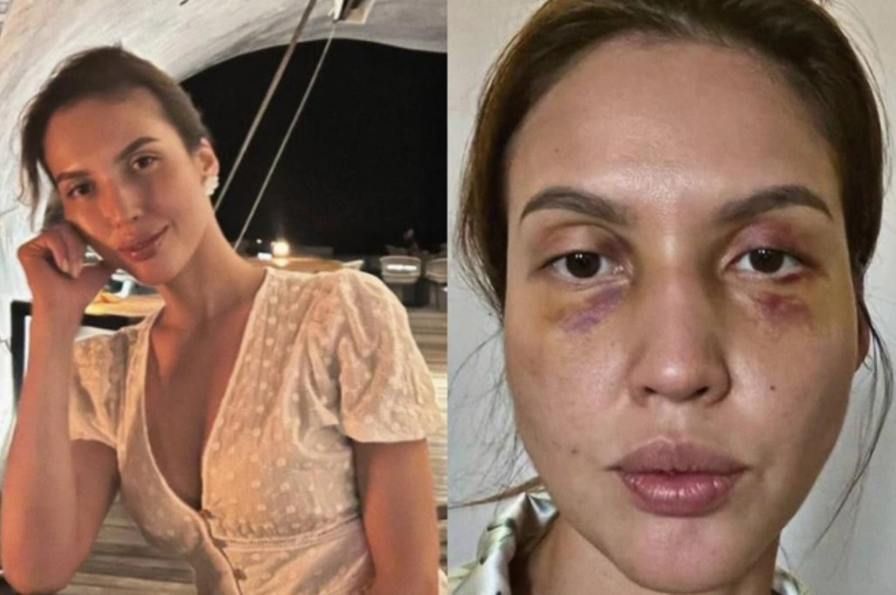
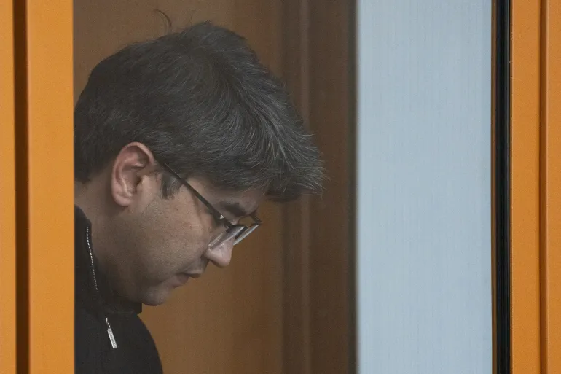
What does the case of Saltanat Nukenova tell us about domestic violence?

Slide 29
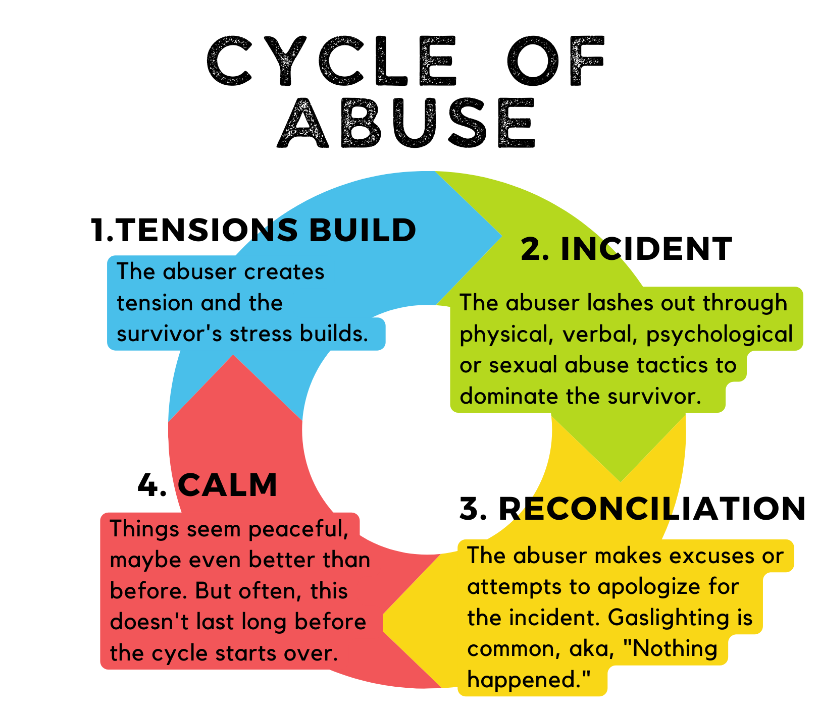
Lenore Walker - The ‘cycle of abuse’ theory

Slide 30
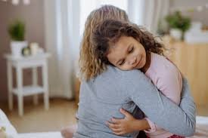
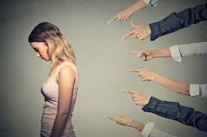
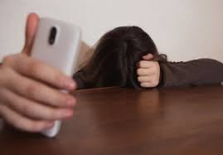
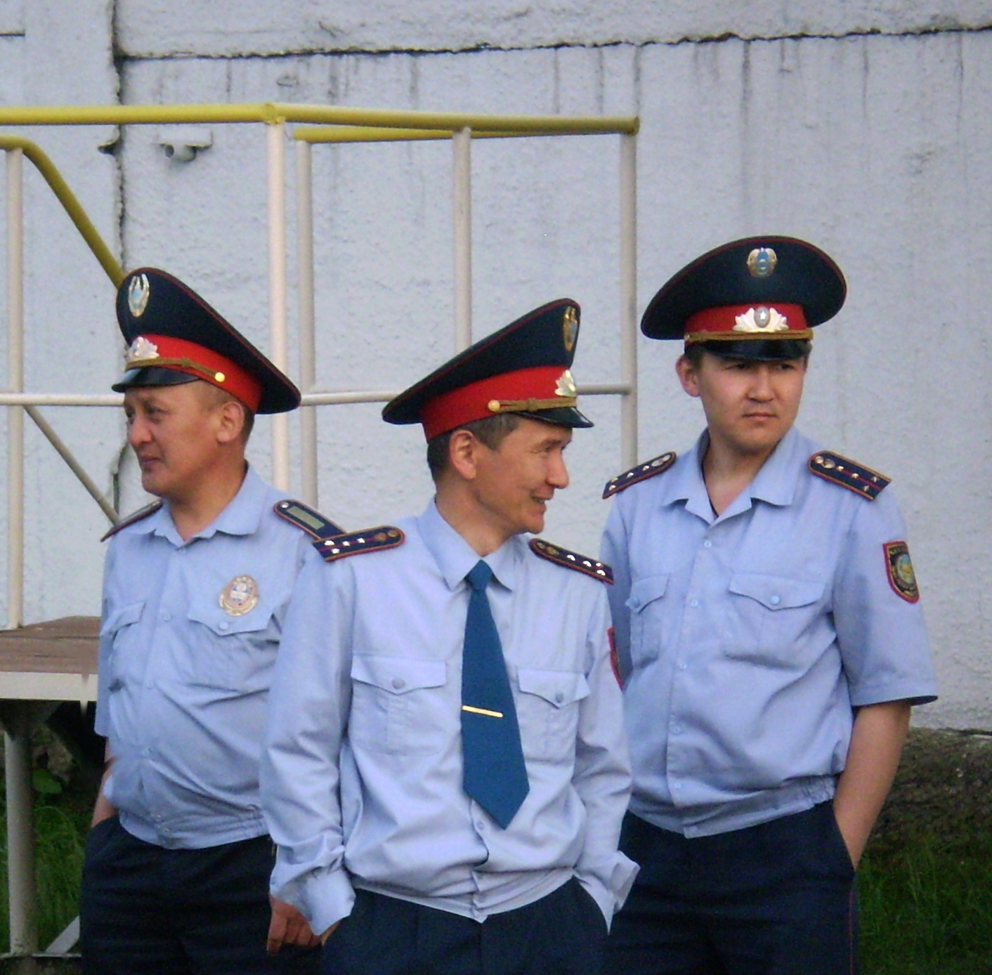
What factors could cause a woman not to report domestic violence against her?

Slide 31
According to Peter Glick and Susan Fiske, what is the difference between hostile sexism and benevolent sexism?
Hostile sexism – explicitly putting women down, anger or resentment toward those who challenge male authority.
Can include: gender-based violence, harassment, discrimination, and derogatory language.
Benevolent sexism, in contrast, is expressed through seemingly positive but patronizing beliefs.
E.g. idea that women are delicate and should be protected by men

Slide 32
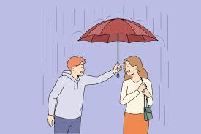

Do you think benevolent sexism is harmful?

